Slide 1

POSCAT Seminar 7 : Dynamic Programming 1
yougatup @ POSCAT

Slide 2
Topic
Topic today
Dynamic Programming
Basic Concept
Longest Increasing Subsequence
Longest Common Subsequence

Slide 3
Dynamic Programming
Problem Solving Paradigm
Identifying a collection of subproblems
Tackling them one by one
smallest first
using the answer already calculated to help figure out the larger ones
until the whole problem is solved
One of the most prominent issue
You can be familiar with PS with Dynamic Programming
There are so many issues to cover

Slide 4
Dynamic Programming
Procedure
Define the Table
Find recurrence relation
Calculate !

Slide 5
Longest Increasing Subsequence
Problem
Find an increasing subsequence of greatest length
5 2 8 6 3 6 9 7

Slide 6
Longest Increasing Subsequence
Problem
Find an increasing subsequence of greatest length
5 2 8 6 3 6 9 7

Slide 7
Longest Increasing Subsequence
Problem
Find an increasing subsequence of greatest length
5 2 8 6 3 6 9 7
1. Define the Table

Slide 8
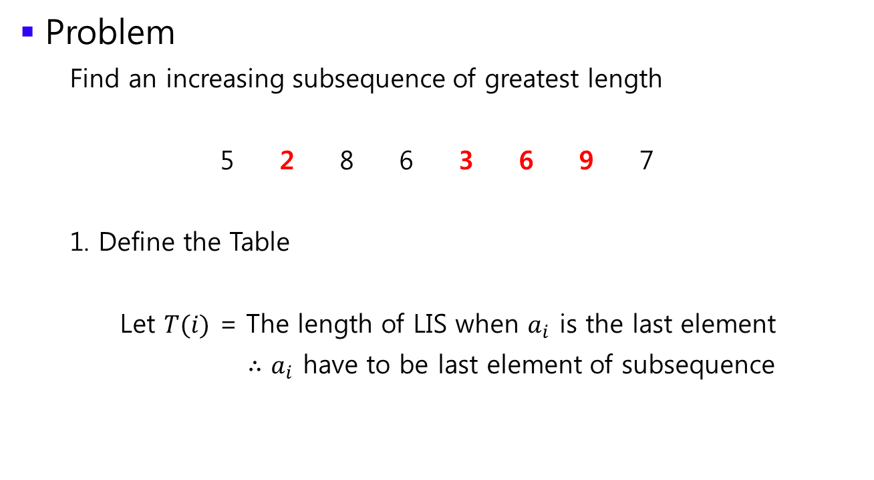
Longest Increasing Subsequence
Problem
Find an increasing subsequence of greatest length
5 2 8 6 3 6 9 7
1. Define the Table
Let $T(i)$ = The length of LIS when $a_{i}$ is the last element
$∴$ $a_{i}$ have to be last element of subsequence

Slide 9
Longest Increasing Subsequence
Problem
Find an increasing subsequence of greatest length
5 2 8 6 3 6 9 7
1. Define the Table
You can fill the table manually. What is the answer ?
index | 0 | 1 | 2 | 3 | 4 | 5 | 6 | 7
Data | 5 | 2 | 8 | 6 | 3 | 6 | 9 | 7
Table | 1 | 1 | 2 | 2 | 2 | 3 | 4 | 4

Slide 10

Longest Increasing Subsequence
Problem
Find an increasing subsequence of greatest length
5 2 8 6 3 6 9 7
1. Define the Table
Can you see the recurrence relation on $T$ ?
index | 0 | 1 | 2 | 3 | 4 | 5 | 6 | 7
Data | 5 | 2 | 8 | 6 | 3 | 6 | 9 | 7
Table | 1 | 1 | 2 | 2 | 2 | 3 | 4 | 4

Slide 11
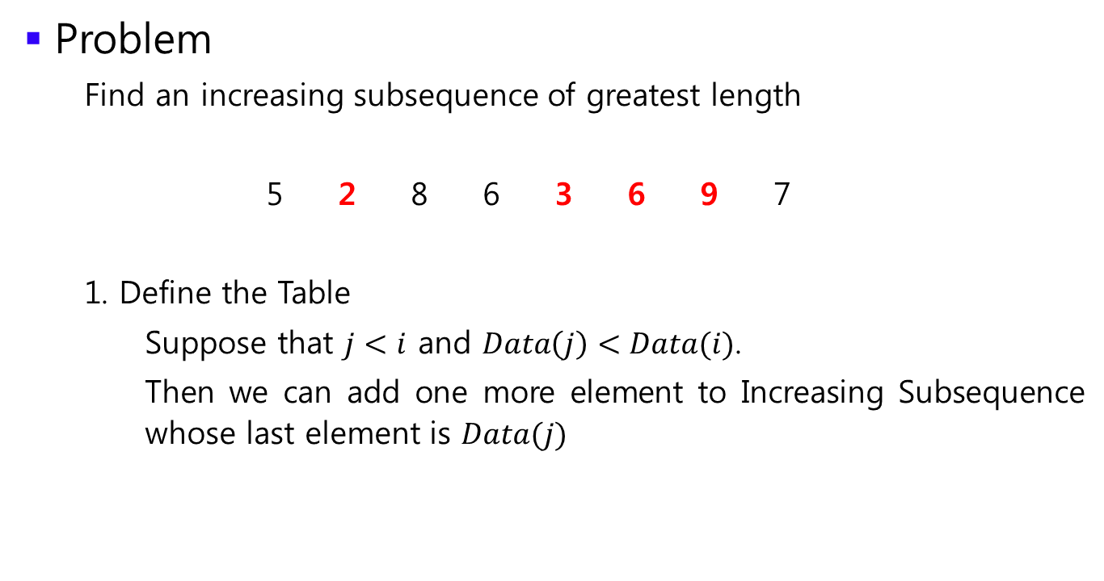
Longest Increasing Subsequence
Problem
Find an increasing subsequence of greatest length
5 2 8 6 3 6 9 7
1. Define the Table
Suppose that $j<i$ and $Data\left(j\right)<Data(i)$.
Then we can add one more element to Increasing Subsequence whose last element is $Data(j)$
index | 0 | 1 | 2 | 3 | 4 | 5 | 6 | 7
Data | 5 | 2 | 8 | 6 | 3 | 6 | 9 | 7
Table | 1 | 1 | 2 | 2 | 2 | 3 | 4 | 4

Slide 12
Longest Increasing Subsequence
Problem
Find an increasing subsequence of greatest length
5 2 8 6 3 6 9 7
1. Define the Table
Consider element 6 in the example.
index | 0 | 1 | 2 | 3 | 4 | 5 | 6 | 7
Data | 5 | 2 | 8 | 6 | 3 | 6 | 9 | 7
Table | 1 | 1 | 2 | 2 | 2 | 3 | 4 | 4

Slide 13
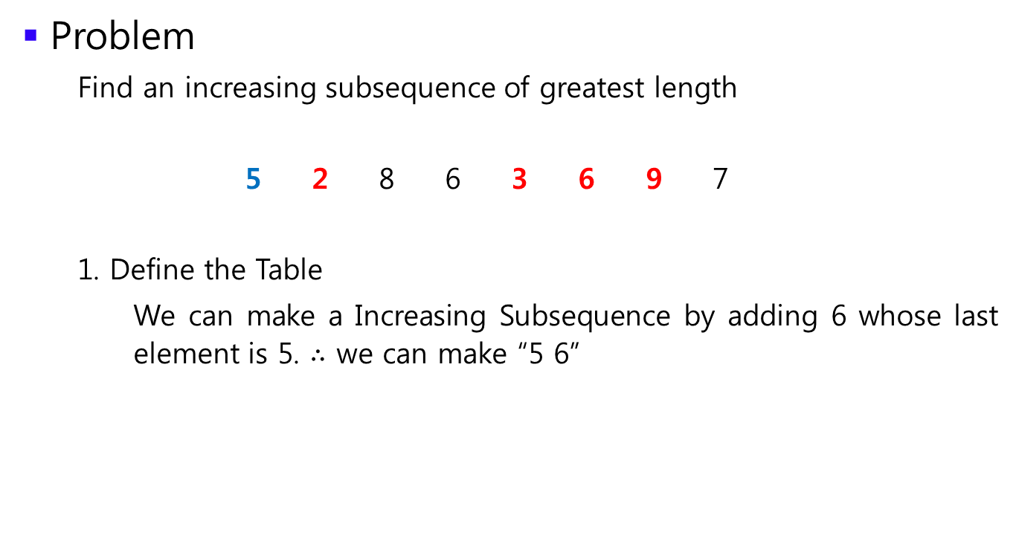
Longest Increasing Subsequence
Problem
Find an increasing subsequence of greatest length
5 2 8 6 3 6 9 7
1. Define the Table
We can make a Increasing Subsequence by adding 6 whose last element is 5. $∴$ we can make “5 6”
index | 0 | 1 | 2 | 3 | 4 | 5 | 6 | 7
Data | 5 | 2 | 8 | 6 | 3 | 6 | 9 | 7
Table | 1 | 1 | 2 | 2 | 2 | 3 | 4 | 4

Slide 14
Longest Increasing Subsequence
Problem
Find an increasing subsequence of greatest length
5 2 8 6 3 6 9 7
1. Define the Table
However, we can make another Increasing Subsequence by considering 2 ! Still the length is 2
index | 0 | 1 | 2 | 3 | 4 | 5 | 6 | 7
Data | 5 | 2 | 8 | 6 | 3 | 6 | 9 | 7
Table | 1 | 1 | 2 | 2 | 2 | 3 | 4 | 4

Slide 15
Longest Increasing Subsequence
Problem
Find an increasing subsequence of greatest length
5 2 8 6 3 6 9 7
1. Define the Table
We can’t make IS with 8 because 8 > 6
index | 0 | 1 | 2 | 3 | 4 | 5 | 6 | 7
Data | 5 | 2 | 8 | 6 | 3 | 6 | 9 | 7
Table | 1 | 1 | 2 | 2 | 2 | 3 | 4 | 4

Slide 16
Longest Increasing Subsequence
Problem
Find an increasing subsequence of greatest length
5 2 8 6 3 6 9 7
1. Define the Table
We can’t
index | 0 | 1 | 2 | 3 | 4 | 5 | 6 | 7
Data | 5 | 2 | 8 | 6 | 3 | 6 | 9 | 7
Table | 1 | 1 | 2 | 2 | 2 | 3 | 4 | 4

Slide 17
Longest Increasing Subsequence
Problem
Find an increasing subsequence of greatest length
5 2 8 6 3 6 9 7
1. Define the Table
We can make ! Therefore, our length is 3.
Note that we considered all the case.
index | 0 | 1 | 2 | 3 | 4 | 5 | 6 | 7
Data | 5 | 2 | 8 | 6 | 3 | 6 | 9 | 7
Table | 1 | 1 | 2 | 2 | 2 | 3 | 4 | 4

Slide 18

Longest Increasing Subsequence
Problem
Find an increasing subsequence of greatest length
5 2 8 6 3 6 9 7
2. Find a recurrence relation
$T\left(i\right)=\max\left(T\left(j\right)+1\right) for all j<i \& Data\left(j\right)<Data(i)$
index | 0 | 1 | 2 | 3 | 4 | 5 | 6 | 7
Data | 5 | 2 | 8 | 6 | 3 | 6 | 9 | 7
Table | 1 | 1 | 2 | 2 | 2 | 3 | 4 | 4

Slide 19
Longest Increasing Subsequence
Problem
Find an increasing subsequence of greatest length
5 2 8 6 3 6 9 7
3. Calculate !
You have to think about where the answer is
index | 0 | 1 | 2 | 3 | 4 | 5 | 6 | 7
Data | 5 | 2 | 8 | 6 | 3 | 6 | 9 | 7
Table | 1 | 1 | 2 | 2 | 2 | 3 | 4 | 4

Slide 20
Longest Increasing Subsequence
Problem
Find an increasing subsequence of greatest length
5 2 8 6 3 6 9 7
3. Calculate !
You have to think about where the answer is
It must be the maximum value of whole Table
index | 0 | 1 | 2 | 3 | 4 | 5 | 6 | 7
Data | 5 | 2 | 8 | 6 | 3 | 6 | 9 | 7
Table | 1 | 1 | 2 | 2 | 2 | 3 | 4 | 4

Slide 21
Longest Increasing Subsequence
Problem
Find an increasing subsequence of greatest length
5 2 8 6 3 6 9 7
Well, we can calculate the length of LIS.
Can we find subsequence itself? i.e. “2 3 6 9” in the example.
index | 0 | 1 | 2 | 3 | 4 | 5 | 6 | 7
Data | 5 | 2 | 8 | 6 | 3 | 6 | 9 | 7
Table | 1 | 1 | 2 | 2 | 2 | 3 | 4 | 4

Slide 22
Longest Increasing Subsequence
Problem
Find an increasing subsequence of greatest length
5 2 8 6 3 6 9 7
Well, we can calculate the length of LIS.
Can we find subsequence itself? i.e. “2 3 6 9” in the example.
That’s possible by writing history !
index | 0 | 1 | 2 | 3 | 4 | 5 | 6 | 7
Data | 5 | 2 | 8 | 6 | 3 | 6 | 9 | 7
Table | 1 | 1 | 2 | 2 | 2 | 3 | 4 | 4

Slide 23
Longest Increasing Subsequence
Problem
Find an increasing subsequence of greatest length
5 2 8 6 3 6 9 7
What is the answer on this example ?
index | 0 | 1 | 2 | 3 | 4 | 5 | 6 | 7
Data | 5 | 2 | 8 | 6 | 3 | 6 | 9 | 7
Table | 1 | 1 | 2 | 2 | 2 | 3 | 4 | 4

Slide 24
Longest Increasing Subsequence
Problem
Find an increasing subsequence of greatest length
5 2 8 6 3 6 9 7
What is the answer on this example ?
index | 0 | 1 | 2 | 3 | 4 | 5 | 6 | 7
Data | 5 | 2 | 8 | 6 | 3 | 6 | 9 | 7
Table | 1 | 1 | 2 | 2 | 2 | 3 | 4 | 4

Slide 25

Longest Increasing Subsequence
Problem
Find an increasing subsequence of greatest length
5 2 8 6 3 6 9 7
What is the answer on this example ?
Then the last element of LIS must be 9 because the definition of $T(i)$ said that $a_{i}$ should be the last element !
index | 0 | 1 | 2 | 3 | 4 | 5 | 6 | 7
Data | 5 | 2 | 8 | 6 | 3 | 6 | 9 | 7
Table | 1 | 1 | 2 | 2 | 2 | 3 | 4 | 4

Slide 26
Longest Increasing Subsequence
Problem
Find an increasing subsequence of greatest length
5 2 8 6 3 6 9 7
Well, 9 is definitely last element of LIS.
How about other elements on LIS ?
index | 0 | 1 | 2 | 3 | 4 | 5 | 6 | 7
Data | 5 | 2 | 8 | 6 | 3 | 6 | 9 | 7
Table | 1 | 1 | 2 | 2 | 2 | 3 | 4 | 4

Slide 27

Longest Increasing Subsequence
Problem
Find an increasing subsequence of greatest length
5 2 8 6 3 6 9 7
Well, 9 is definitely last element of LIS.
How about other elements on LIS ?
$T(6)$ is 4 because we add 9 to the end of IS whose last element is 6
index | 0 | 1 | 2 | 3 | 4 | 5 | 6 | 7
Data | 5 | 2 | 8 | 6 | 3 | 6 | 9 | 7
Table | 1 | 1 | 2 | 2 | 2 | 3 | 4 | 4

Slide 28
Longest Increasing Subsequence
Problem
Find an increasing subsequence of greatest length
5 2 8 6 3 6 9 7
Therefore, 6 have to be located on the left of 9
index | 0 | 1 | 2 | 3 | 4 | 5 | 6 | 7
Data | 5 | 2 | 8 | 6 | 3 | 6 | 9 | 7
Table | 1 | 1 | 2 | 2 | 2 | 3 | 4 | 4

Slide 29
Longest Increasing Subsequence
Problem
Find an increasing subsequence of greatest length
5 2 8 6 3 6 9 7
Therefore, 6 have to be located on the left of 9
Repeat this procedure until we have no former element
index | 0 | 1 | 2 | 3 | 4 | 5 | 6 | 7
Data | 5 | 2 | 8 | 6 | 3 | 6 | 9 | 7
Table | 1 | 1 | 2 | 2 | 2 | 3 | 4 | 4

Slide 30
Longest Increasing Subsequence
Problem
Find an increasing subsequence of greatest length
5 2 8 6 3 6 9 7
Therefore, 6 have to be located on the left of 9
Repeat this procedure until we have no former element
It has no former element !
index | 0 | 1 | 2 | 3 | 4 | 5 | 6 | 7
Data | 5 | 2 | 8 | 6 | 3 | 6 | 9 | 7
Table | 1 | 1 | 2 | 2 | 2 | 3 | 4 | 4

Slide 31

Longest Increasing Subsequence
Problem
Find an increasing subsequence of greatest length
5 2 8 6 3 6 9 7
We call this procedure as “Backtrace”
To implement Backtrace, we have to write down the history.
index | 0 | 1 | 2 | 3 | 4 | 5 | 6 | 7
Data | 5 | 2 | 8 | 6 | 3 | 6 | 9 | 7
Table | 1 | 1 | 2 | 2 | 2 | 3 | 4 | 4
Hist. | None | None | 1 | 1 | 1 | 4 | 5 | 5
It means that former element of $a_{5}$ is $a_{4}$ !

Slide 32
Longest Increasing Subsequence
Problem
Find an increasing subsequence of greatest length
5 2 8 6 3 6 9 7
Implement it ☺. It is very easy to make a stress of yours
index | 0 | 1 | 2 | 3 | 4 | 5 | 6 | 7
Data | 5 | 2 | 8 | 6 | 3 | 6 | 9 | 7
Table | 1 | 1 | 2 | 2 | 2 | 3 | 4 | 4
Hist. | None | None | 1 | 1 | 1 | 4 | 5 | 5

Slide 33
Longest Common Subsequence
Problem
Find an Longest Common Subsequence
S N O W Y
S U N N Y

Slide 34
Longest Common Subsequence
Problem
Find an Longest Common Subsequence
S N O W Y
S U N N Y

Slide 35
Longest Common Subsequence
Problem
Find an Longest Common Subsequence
S N O W Y
S U N N Y
Define the Table
Give me !

Slide 36

Longest Common Subsequence
Problem
Find an Longest Common Subsequence
S N O W Y
S U N N Y
Define the Table
Let $T(i, j)$ = The length of LCS between $(a_{1}\sim a_{i})$ and ($b_{1}\sim b_{j}$)

Slide 37
Longest Common Subsequence
Problem
Find an Longest Common Subsequence
S N O W Y
S U N N Y
Define the Table Fill it manually !
 | S | N | O | W | Y
S
U
N
N
Y

Slide 38
Longest Common Subsequence
Problem
Find an Longest Common Subsequence
S N O W Y
S U N N Y
Define the Table How can we feel it ?
 | S | N | O | W | Y
S | 1 | 1 | 1 | 1 | 1
U | 1 | 1
N
N
Y

Slide 39
Longest Common Subsequence
Problem
Find an Longest Common Subsequence
S N O W Y
S U N N Y
Consider this situation.
 | S | N | O | W | Y
S | 1 | 1 | 1 | 1 | 1
U | 1 | 1
N
N
Y

Slide 40
Longest Common Subsequence
Problem
Find an Longest Common Subsequence
S N O W Y
S U N N Y
First of all, we can’t “match” O and U because they are different
 | S | N | O | W | Y
S | 1 | 1 | 1 | 1 | 1
U | 1 | 1
N
N
Y

Slide 41
Longest Common Subsequence
Problem
Find an Longest Common Subsequence
S N O W Y
S U N N Y
Therefore, we can remove one or both element
 | S | N | O | W | Y
S | 1 | 1 | 1 | 1 | 1
U | 1 | 1
N
N
Y

Slide 42
Longest Common Subsequence
Problem
Find an Longest Common Subsequence
S N O W Y
S U N N Y
What is the length of LCS when we remove O ?
 | S | N | O | W | Y
S | 1 | 1 | 1 | 1 | 1
U | 1 | 1
N
N
Y

Slide 43
Longest Common Subsequence
Problem
Find an Longest Common Subsequence
S N O W Y
S U N N Y
What is the length of LCS when we remove O ?
It knows !
 | S | N | O | W | Y
S | 1 | 1 | 1 | 1 | 1
U | 1 | 1
N
N
Y

Slide 44
Longest Common Subsequence
Problem
Find an Longest Common Subsequence
S N O W Y
S U N N Y
What is the length of LCS when we remove U ?
 | S | N | O | W | Y
S | 1 | 1 | 1 | 1 | 1
U | 1 | 1
N
N
Y

Slide 45
Longest Common Subsequence
Problem
Find an Longest Common Subsequence
S N O W Y
S U N N Y
What is the length of LCS when we remove U ?
It has !
 | S | N | O | W | Y
S | 1 | 1 | 1 | 1 | 1
U | 1 | 1
N
N
Y

Slide 46
Longest Common Subsequence
Problem
Find an Longest Common Subsequence
S N O W Y
S U N N Y
Therefore, the value of this entry is 1
 | S | N | O | W | Y
S | 1 | 1 | 1 | 1 | 1
U | 1 | 1 | 1
N
N
Y

Slide 47
Longest Common Subsequence
Problem
Find an Longest Common Subsequence
S N O W Y
S U N N Y
How about this situation ?
 | S | N | O | W | Y
S | 1 | 1 | 1 | 1 | 1
U | 1 | 1 | 1 | 1 | 1
N | 1
N
Y

Slide 48
Longest Common Subsequence
Problem
Find an Longest Common Subsequence
S N O W Y
S U N N Y
We can match N! because they are the same
 | S | N | O | W | Y
S | 1 | 1 | 1 | 1 | 1
U | 1 | 1 | 1 | 1 | 1
N | 1
N
Y

Slide 49
Longest Common Subsequence
Problem
Find an Longest Common Subsequence
S N O W Y
S U N N Y
Then, the LCS must be (LCS between “S” and “SU”) + N
 | S | N | O | W | Y
S | 1 | 1 | 1 | 1 | 1
U | 1 | 1 | 1 | 1 | 1
N | 1
N
Y

Slide 50
Longest Common Subsequence
Problem
Find an Longest Common Subsequence
S N O W Y
S U N N Y
Therefore, we get SN. In addition, the value of this entry is 2
 | S | N | O | W | Y
S | 1 | 1 | 1 | 1 | 1
U | 1 | 1 | 1 | 1 | 1
N | 1 | 2
N
Y

Slide 51
Longest Common Subsequence
Problem
Find an Longest Common Subsequence
S N O W Y
S U N N Y
Can you see the recurrence relation ?
 | S | N | O | W | Y
S | 1 | 1 | 1 | 1 | 1
U | 1 | 1 | 1 | 1 | 1
N | 1 | 2 | 2 | 2 | 2
N | 1 | 2 | 2 | 2 | 2
Y | 1 | 2 | 2 | 2 | 3

Slide 52
Longest Common Subsequence
Problem
Find an Longest Common Subsequence
S N O W Y
S U N N Y
2. Find a recurrence relation

Slide 53

Longest Common Subsequence
Problem
Find an Longest Common Subsequence
S N O W Y
S U N N Y
2. Find a recurrence relation
$T\left(i, j\right)=T\left(i−1, j−1\right)+1 if a_{i}=b_{j}$
$\max\left( T\left(i−1, j\right), T\left(i, j−1\right) \right) otherwise$

Slide 54
Longest Common Subsequence
Problem
Find an Longest Common Subsequence
S N O W Y
S U N N Y
3. Calculate !
Think about backtrace. It will be easy if you understand DP well.

Slide 55
Dynamic Programming
Remember. 3 step is enough.
The first step is the most important thing. Finding the recurrence relation is not that hard commonly.
I showed somewhat detail explanation of solving procedure because it is first time to you
From the next time, I will just let you know what the definition of Table and the recurrent relation is
Please solve all the problem

